Slide 1
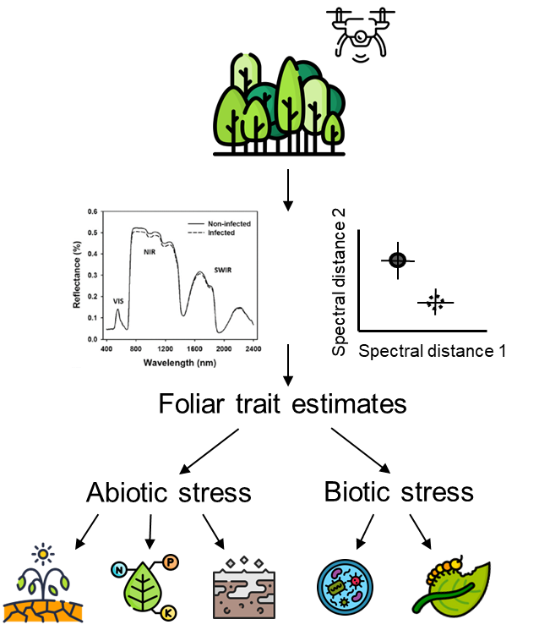
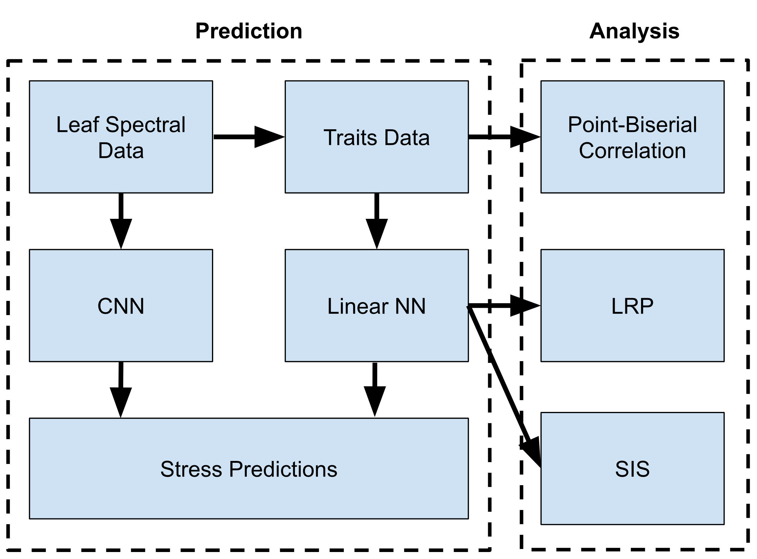
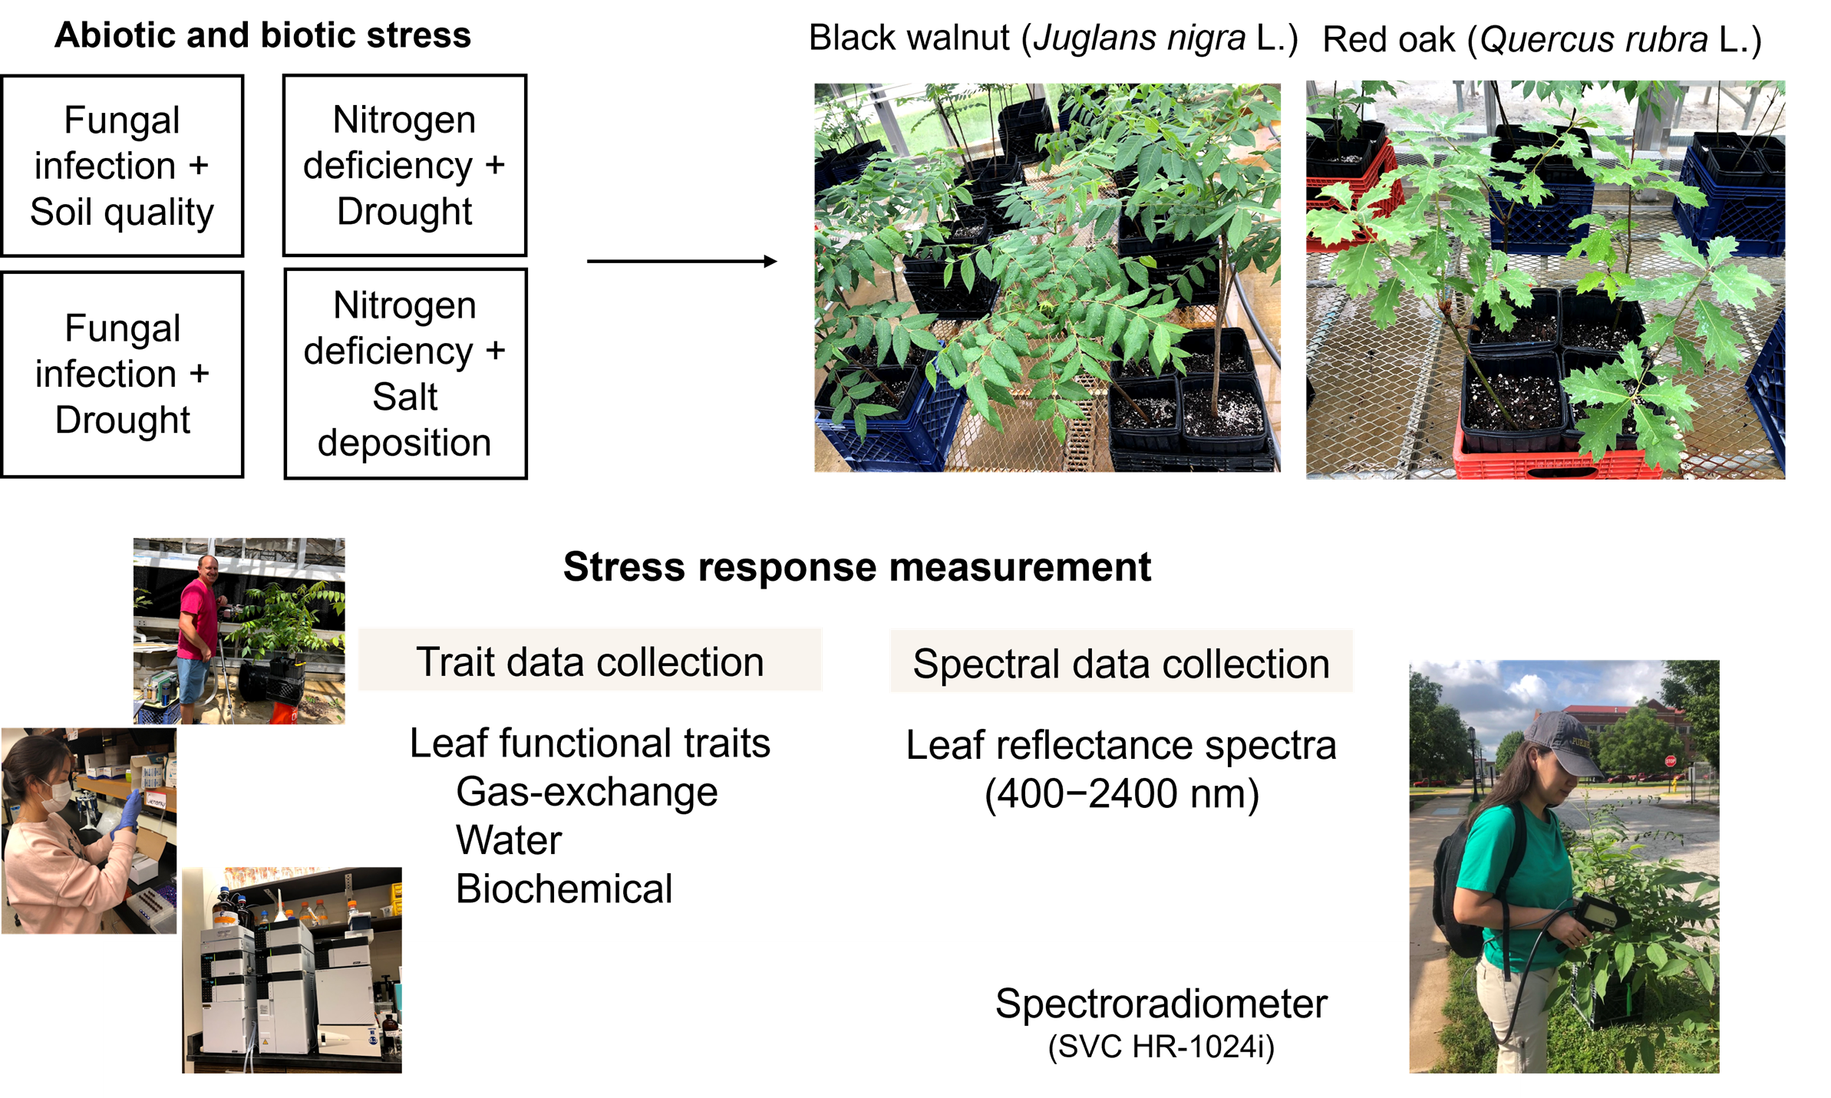


INSTITUTE FOR DIGITAL FORESTRY
Predicting Tree Stresses With Hyperspectral Reflectance Spectroscopy
Aditya Tiwari, Sylvia Park, John Couture
ABSTRACT
Background
Data Analysis
Results
Forest health monitoring is vital for management, but traditional methods for determining tree stress are under are time-consuming and logistically challenging. One alternative is hyperspectral data , which can rely information about plant physiochemical status non-destructively.
One-year-old black walnut (Juglans nigra L.) and northern red oak (Quercus rubra L.) were exposed to biotic and abiotic stress events, including pathogens, water stress, nutrient deficiency, and salt deposition. Hyperspectral measurements spanning 350−2500 nm were collected on leaf tissue in coordination with plant physiochemical parameters related with photosynthesis, water relations, and biochemical compounds. A convolutional neural network was trained on these data to determine anomalous spectral data under the different stress conditions. A second neural network was trained on physiochemical traits data derived from the hyperspectral data to classify individual stresses. Meta-analysis of this neural network was used to develop associations between traits and stresses.
Spectral data separated from control and stressed trees, identifying anomalous data associated with stress, and spectrally-estimated trait data were able to identify individual stress conditions with high accuracy. Individual traits important to classification were biologically related with tree stress conditions.
Monitoring of forest health is vital for effective management, but traditional methods are time-consuming and logistically challenging.
While hyperspectral data has been used to increase the efficiency of differentiating stressed plants from healthy ones, the development and testing of algorithms for stress-specific decision-making using spectrally predicted plant traits, and improving their accuracy, remain largely unexplored.
Utilizing machine learning, particularly in predictive modeling and classification, can help extrapolate hyperspectral data to monitor and predict future forest conditions, thereby aiding in proactive forest management.
A CNN was trained on the spectral data to predict whether the sample was stressed or not
A linear NN was trained on the traits data to predict what individual stresses were present.
Various meta-analyses were performed on the traits-based model to determine which traits were most associated with given stressors.
Layer-wise Relevance Propagation (LRP)
Sufficient Input Subsets (SIS)
Spectral Model Accuracy | Traits Model Accuracy
99.57% | 99.81%
No significant correlation was found between any single trait and any stress using point-biserial correlation
LRP - Selected important traits for classification of individual stress conditions.
Geosmithia morbida infection: Glucose
Fusarium solani infection: N, Gallic acid, PI
Drought: N, Gallic acid, F_{v}/F_{o}, PI
Nutrient Deficiency: F_{v}/F_{o}
Salinity: F_{v}/F_{o}, WUE_{in}, Zeaxanthin
SIS – Retained traits not unimportant for classification of individual stress conditions.
Geosmithia morbida infection: Sugars, Starch, Ellagic acid, Gallic acid, Rutin, CTs
Fusarium solani infection: LWC, Chl a, Sucrose, Sugars, Starch, Ellagic acid, Gallic acid, Rutin, CTs
Drought: Water Potential, N, C, Neoxanthin, Violaxanthin, Lutein, Zeaxanthin, Chl b, Chl a, β-carotene, Glucose, Fructose, Sucrose, Sugars, Starch, Ellagic acid, Gallic acid, Rutin, CTs
Nutrient Deficiency: Gallic acid
Salinity: Violaxanthin, Lutein, Zeaxanthin, Chl b, Chl a, β-carotene, Glucose, Fructose, Sucrose, Sugars, Starch, Ellagic acid, Gallic acid, Rutin, CTs
Objectives
To develop and refine machine learning algorithms capable of identifying and classifying 1) anomalous spectral data and 2) individual stress factors in trees based on tree functional trait responses
Data Collection
Black walnut and red oak seedlings were exposed to the combination of abiotic and biotic stressors in a greenhouse.
Leaf spectral data were collected using Spectra Vista HR 1024i spectroradiometer
Leaf physiochemical traits data were collected using standard analytical approaches.
Leaf trait estimates were obtained by training partial least squares regression models on leaf reflectance spectra and measured leaf traits
*CTs = Condensed Tannins
F_{v}/F_{m} = Maximum quantum yield of the PSII
F_{v}/F_{o} = Maximum primary yield of PSII photochemistry
WUE_{in} = Intrinsic water-use efficiency
PI = Performance Index
LWC = Leaf water content
Outcomes
PRESENTER BIO INFORMATION
Hyperspectral data non-destructively identifies biotic and abiotic stressors by detecting changes in leaf physiochemical properties, providing stress-specific insights into tree responses.
A layered understanding of stress-specific responses using hyperspectral analysis can improve our ability to monitor forest health, and eventually help guide forest management decisions
Aditya Tiwari
CS Undergrad
tiwari60@purdue.edu
Presenter photo
Acknowledgement of funding support: ​
PERSEUS grant #2023-68012-38992, USDA NIFA; Purdue University Institute for Digital Forestry ; and the Hardwood Tree Improvement and Regeneration Center.

Slide 2
INSTITUTE FOR DIGITAL FORESTRY
POSTER TITLE GOES HERE
Authors and co-authors
ABSTRACT
SUBHEAD FONT
Example font for abstract
This is the secondary text which will explain your project.
Example bullet list 1:
Text 1
Text 2
Text 3
Text 4
Example bullet list 2:
Text 1
Text 2
Text 3
Text 4
Example of divisions:
Purdue Boilermaker Gold - R-207, G-185, B-145
Purdue Steel Gray - R-85, G-89, B-96
Purdue Black - R-00, G-00, B-00
Short caption font for figure or tables.
References font.
RGB numbers:
banner background = Purdue Boilermaker Gold - R-207, G-185, B-145
“Every Tree” background = Purdue Steel Gray - R-85, G-89, B-96
Every Tree “Measuring” gold = Purdue Boilermaker Gold - R-207, G-185, B-145
Abstract background = Purdue Steam Gray – R-196, G-191, B-192
PRESENTER BIO INFORMATION
Given Family name
Brief poster presenter bio
Include photo
Include contact info
Include QR code to website if available
Presenter photo
Acknowledgement of funding support: ​
<PERSEUS grant #2023-68012-38992, USDA NIFA> or <EFFICACI grant, #NR233A750004G044, USDA NRCS> or <Purdue University Institute for Digital Forestry > or <other…>

Slide 3

